Slide 1
Ok - Eclipse II
Group D

Slide 2
Ok what’s OkEclipse?

Slide 3
Version I
User can recite menu options
The command Find lets one find solutions to an issue in the console
Program simple one line sentences like getters and setters , main method and String generation through voice commands.

Slide 4
Version II
Github Integration using voice commands
Code Generation using simple substructure through voice commands.
Code Conversion using voice commands.
Unit Test generation of test suites using voice commands.

Slide 5
Github Integration

Slide 6
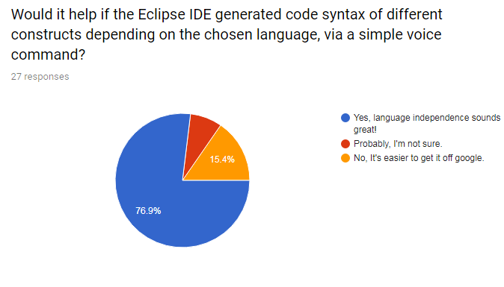
Code Generation
Tell Eclipse to generate a small code substructure by a simple command.
Just say “ Generate ” or type Shift & G
Notes:
The question was : Would it help if Eclipse generated simple code substructure of different constructs , via a voice command ,depending on the language chosen?
For now we worked on Java.

Slide 7
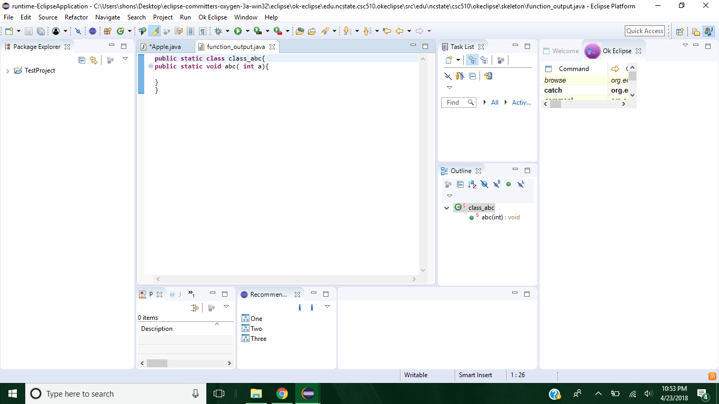
Code Generation
Generate …
A function / method with given name , number of parameters and return type.

Slide 8
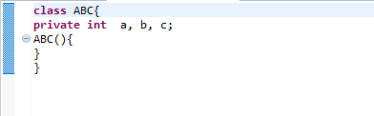
Code Generation
Generate
A class with a given name , access type and variables.

Slide 9
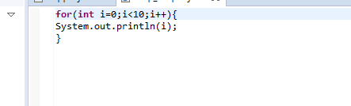
Code Generation
Generate
A simple loop with given number of iterations.
Notes:
Benefits :
Good start for new learners.
Saves efforts of typing a structure, even avoiding trivial syntactical errors.
Less reference to internet , less plagriasm.
Good for lazy people.

Slide 10
Code Conversion

Slide 11
Unit Tests

Slide 12
Technology Stack
Languages : Java , Python
Libraries : Agitar One (java unit testing), java2python (java to python conversion), Sphinx (voice detection)
Environment : Eclipse IDE version 3.

Slide 13
What others had to say about it

Slide 14
Challenges

Slide 15
Limitations (Read : Future Work)
Code Generation is implemented only in Java. Could be implemented in other language extensions too.
Code generated are of small simple syntax. Can be extended to complex structures.
Voice recognition cannot take in more than one word at a time. Can be extended to sentence.

Slide 16
Conclusion

